Slide 1
Snowflake Steps :- Create Account,Classice Console

Slide 2
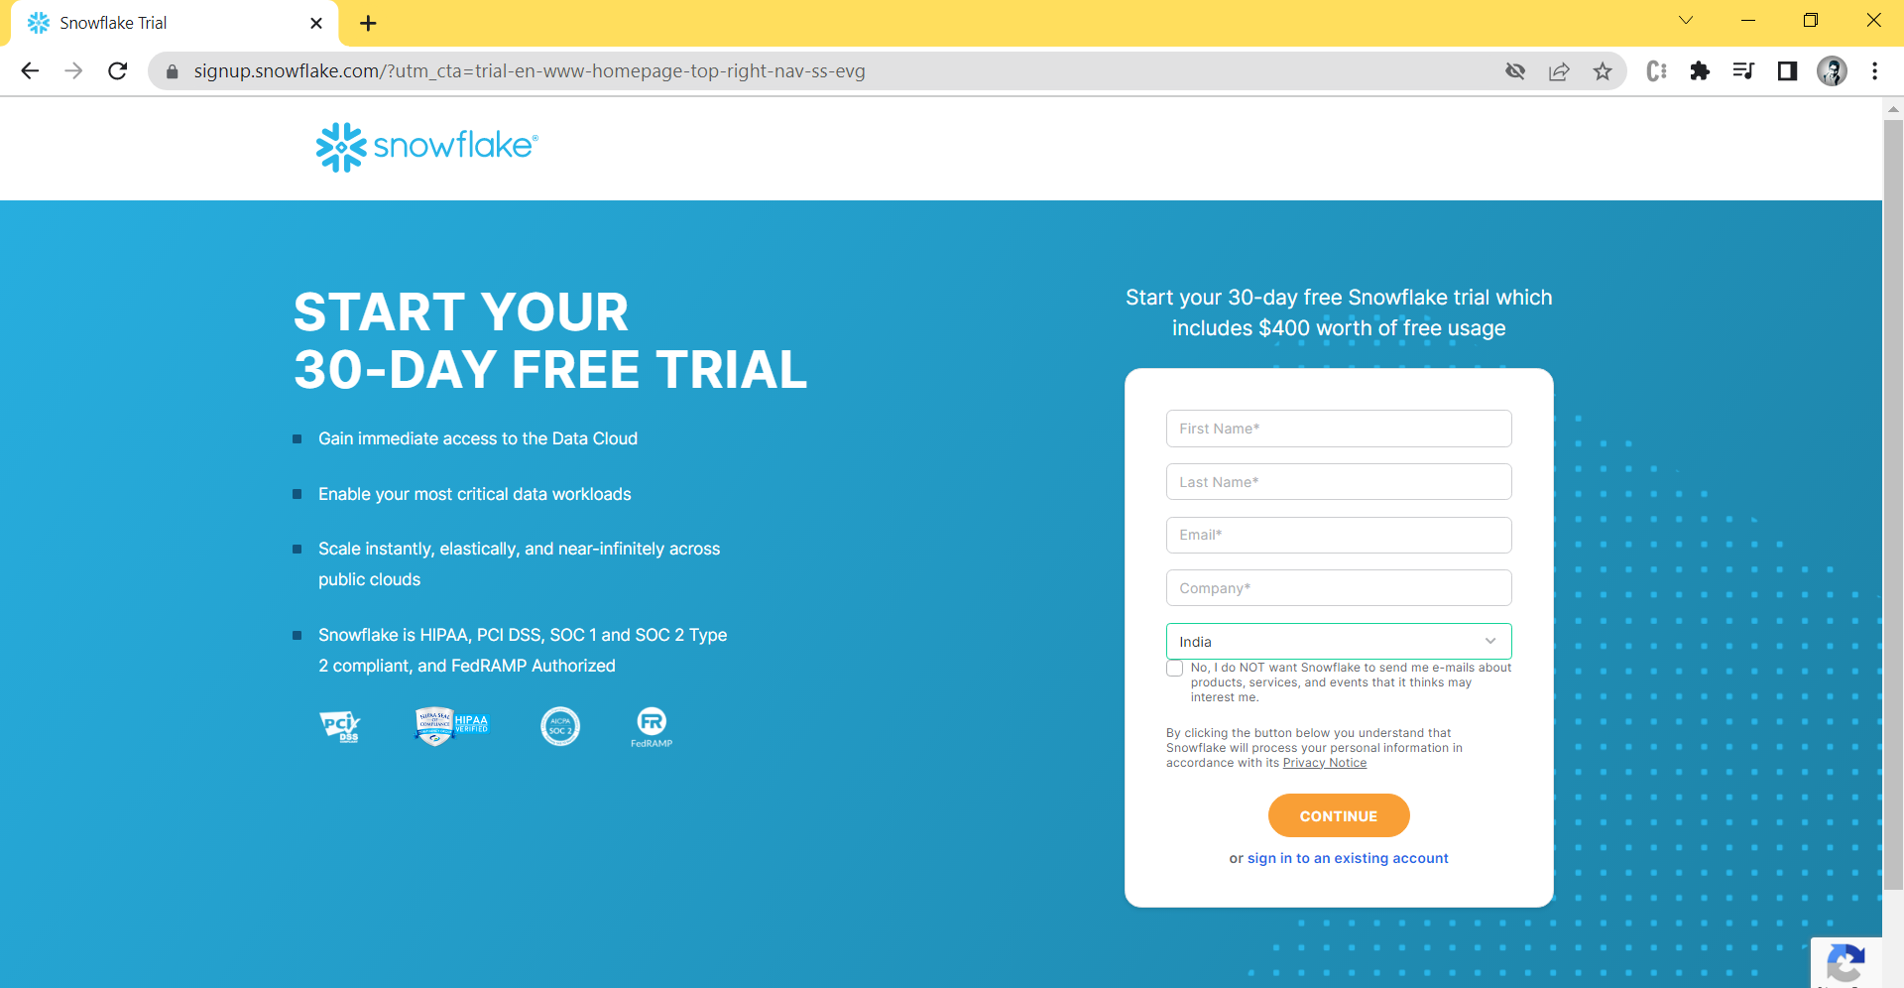
Step 1:- create a free account.

Slide 3

Step 2 : fill the detail and give valid email address so the mail come for verification, in company filled any thing you write.

Slide 4
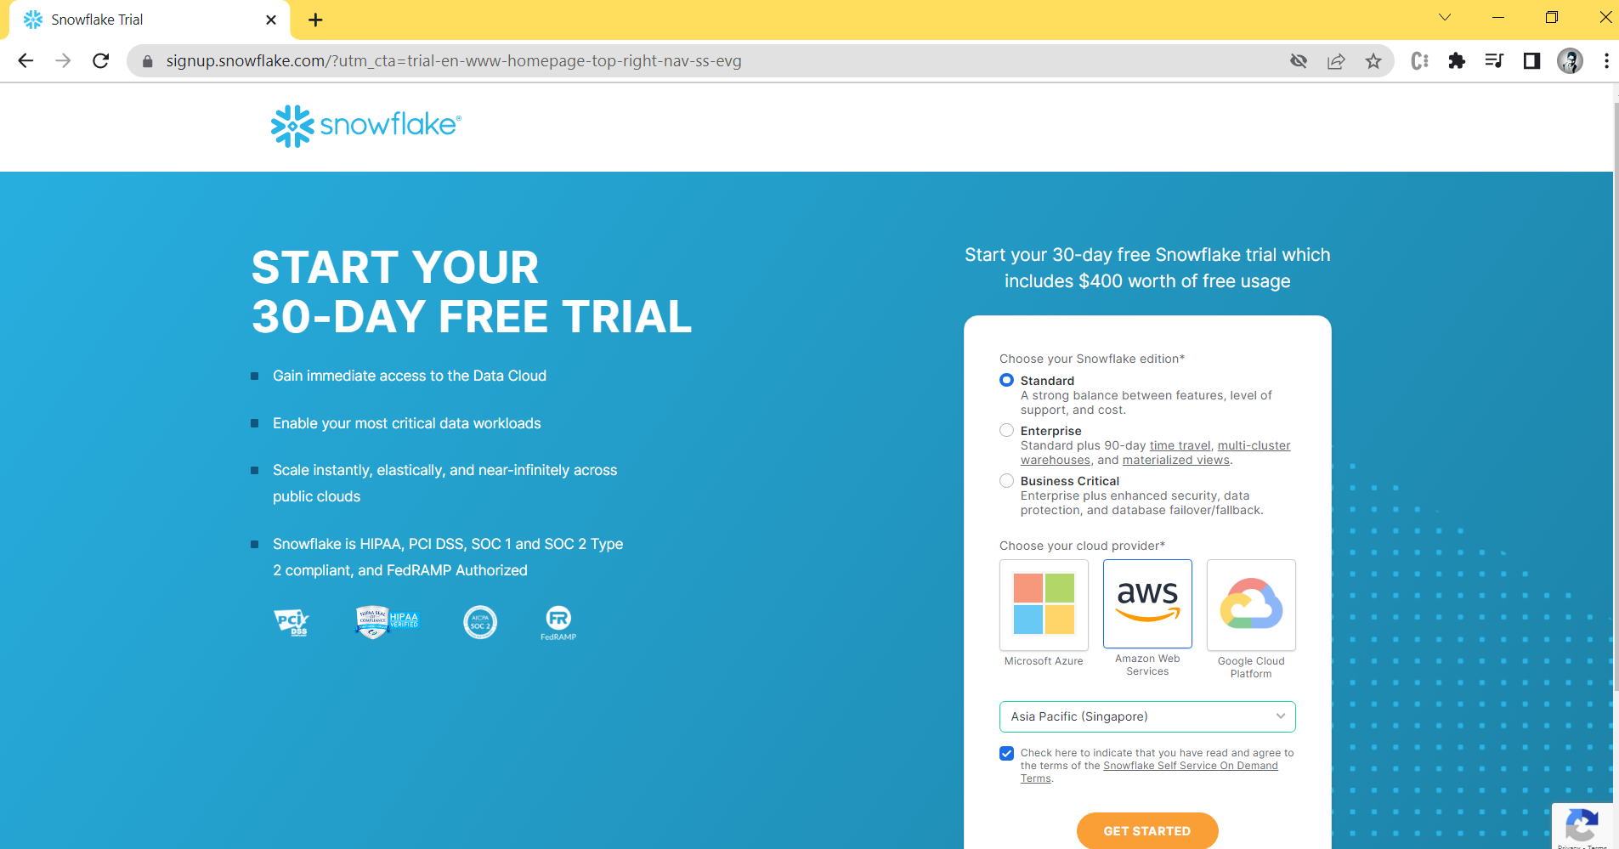
Step 3:- select a edition “standard “then select cloud provider “Aws” and then select any region and enter a get started.

Slide 5
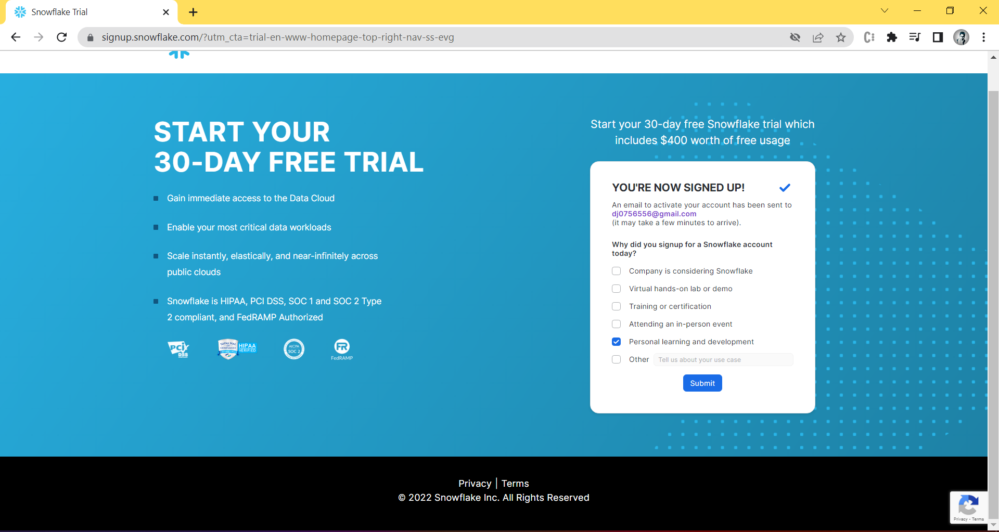
Step 4 :- They send a mail in given email id and verified. Select any of the box.

Slide 6
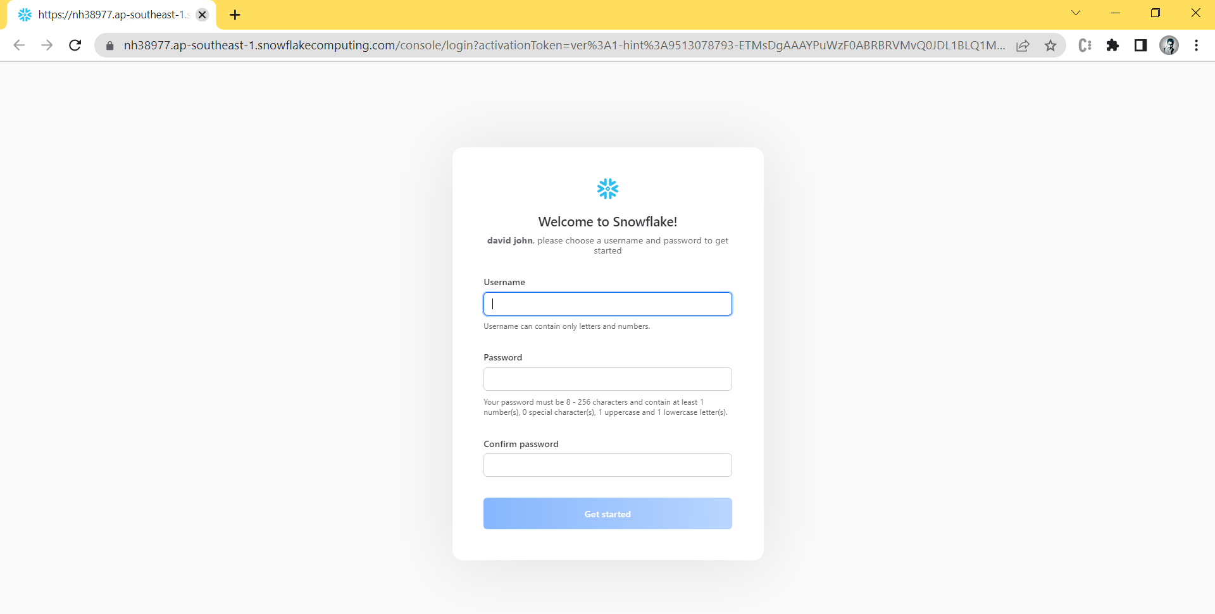
Step 5 :- After verified create username and password

Slide 7
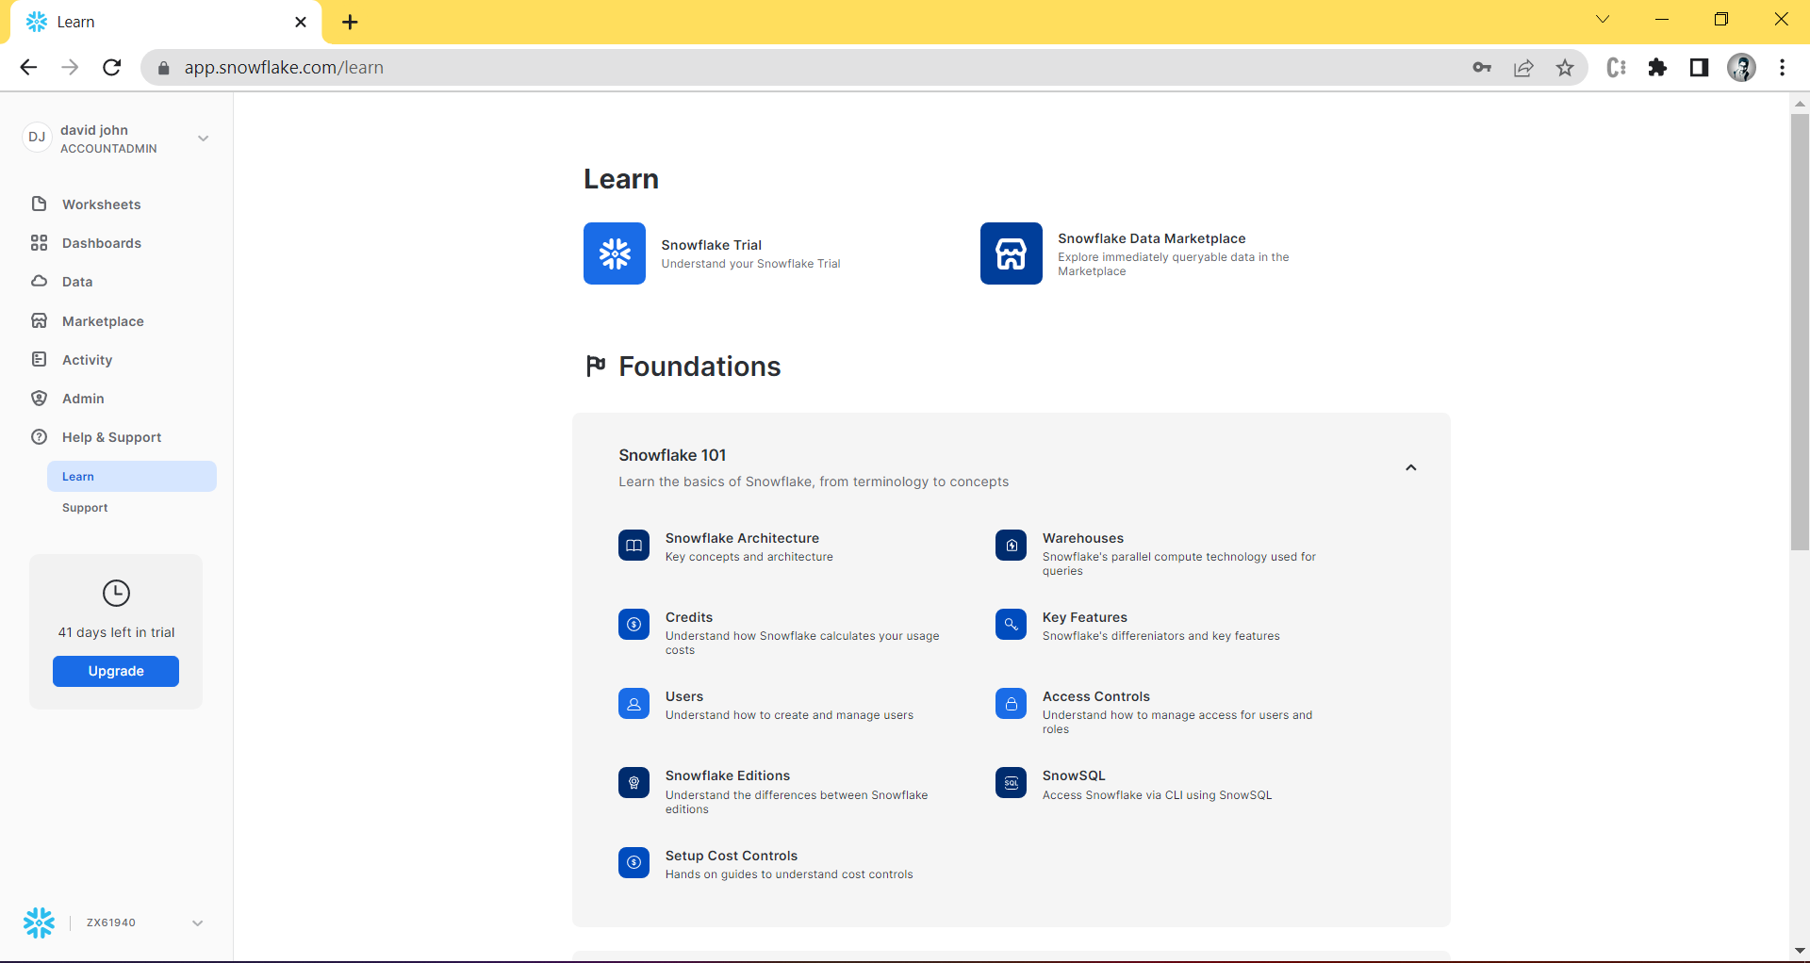
Step 6 :- snowflake page open.

Slide 8
Create a classic Console

Slide 9
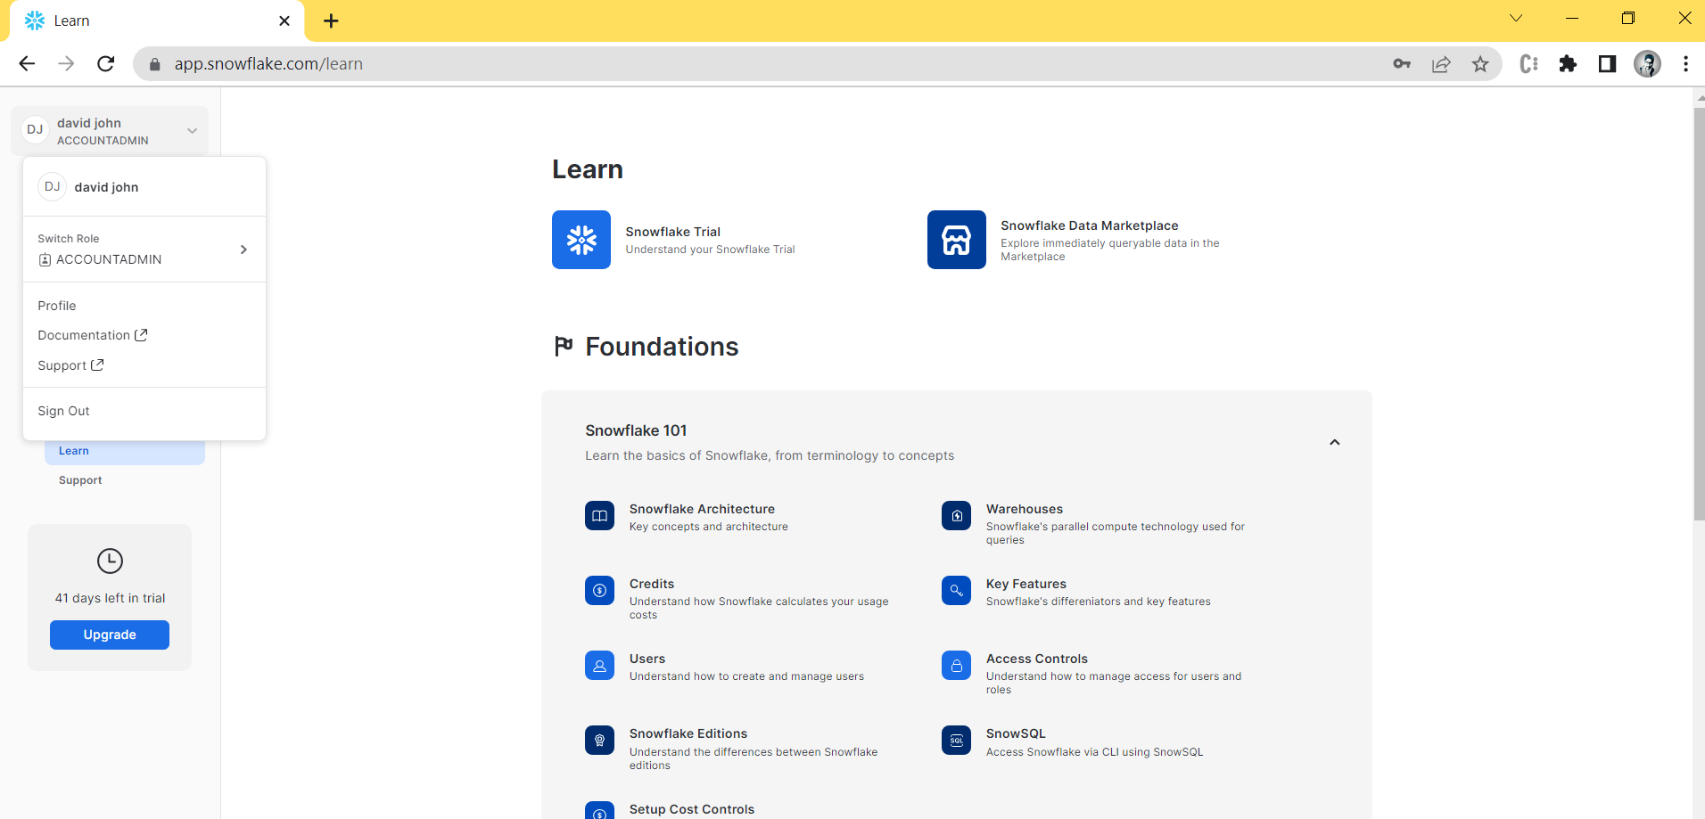
Step 1:- click a username place and show dropdown box click on profile.

Slide 10
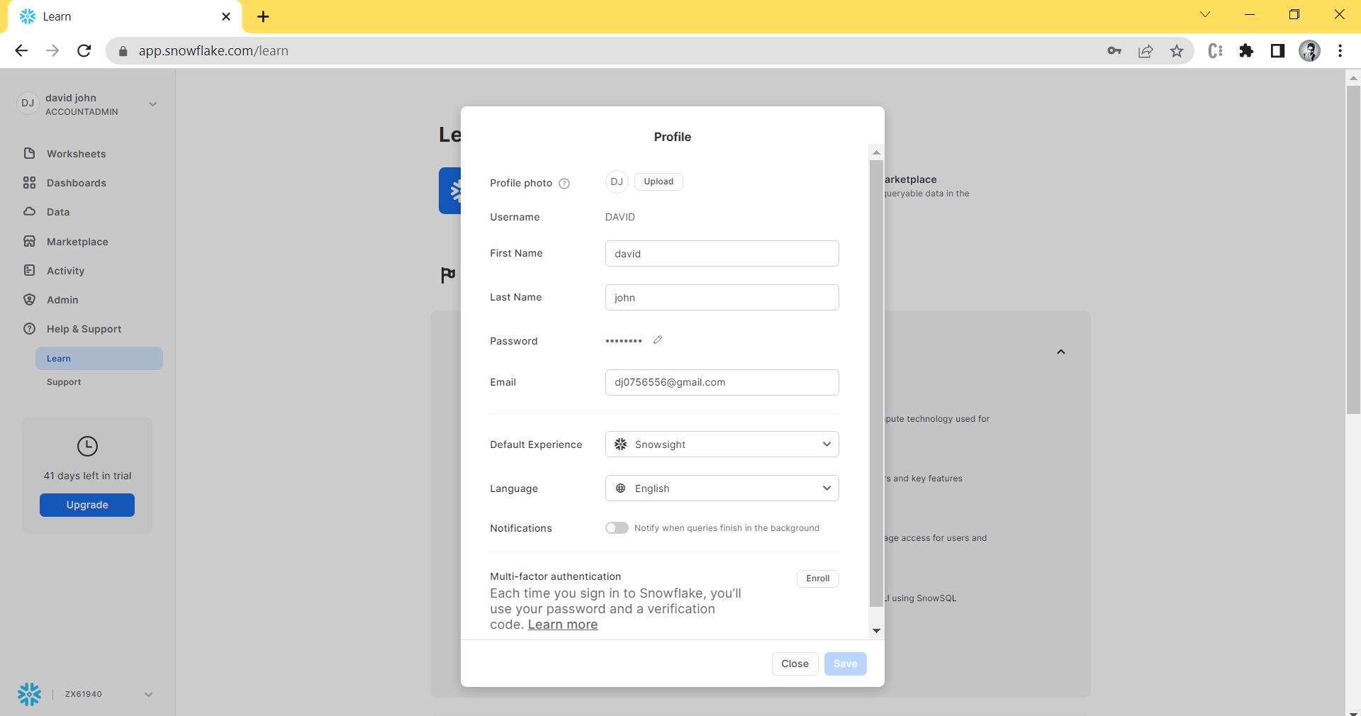
Step2 :- Profile Page Open. Select a Default Experience.

Slide 11
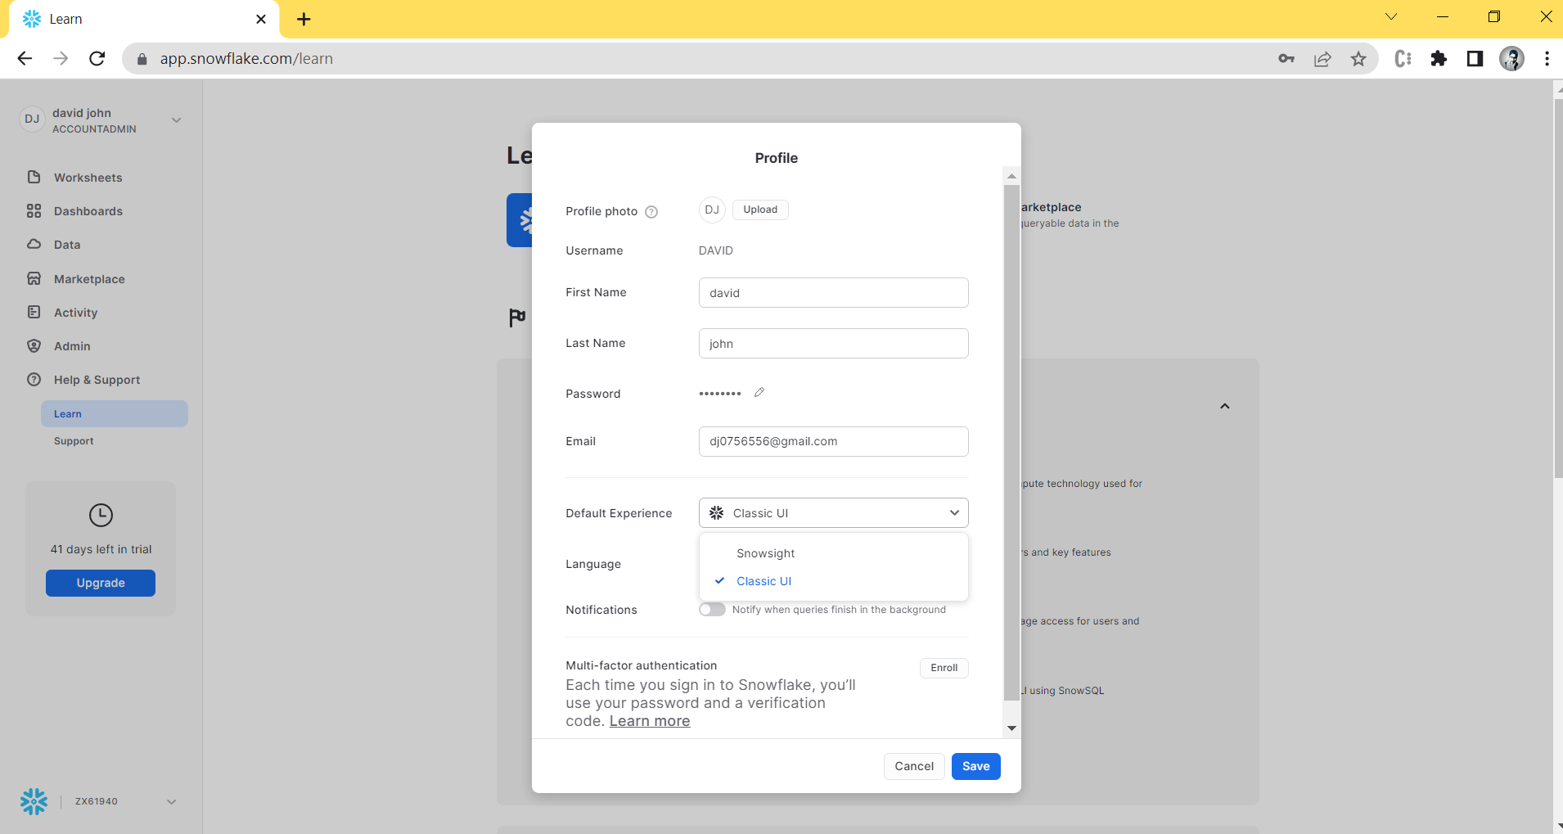
Step 3:- And Select a “Classic UI” and “Save”.

Slide 12
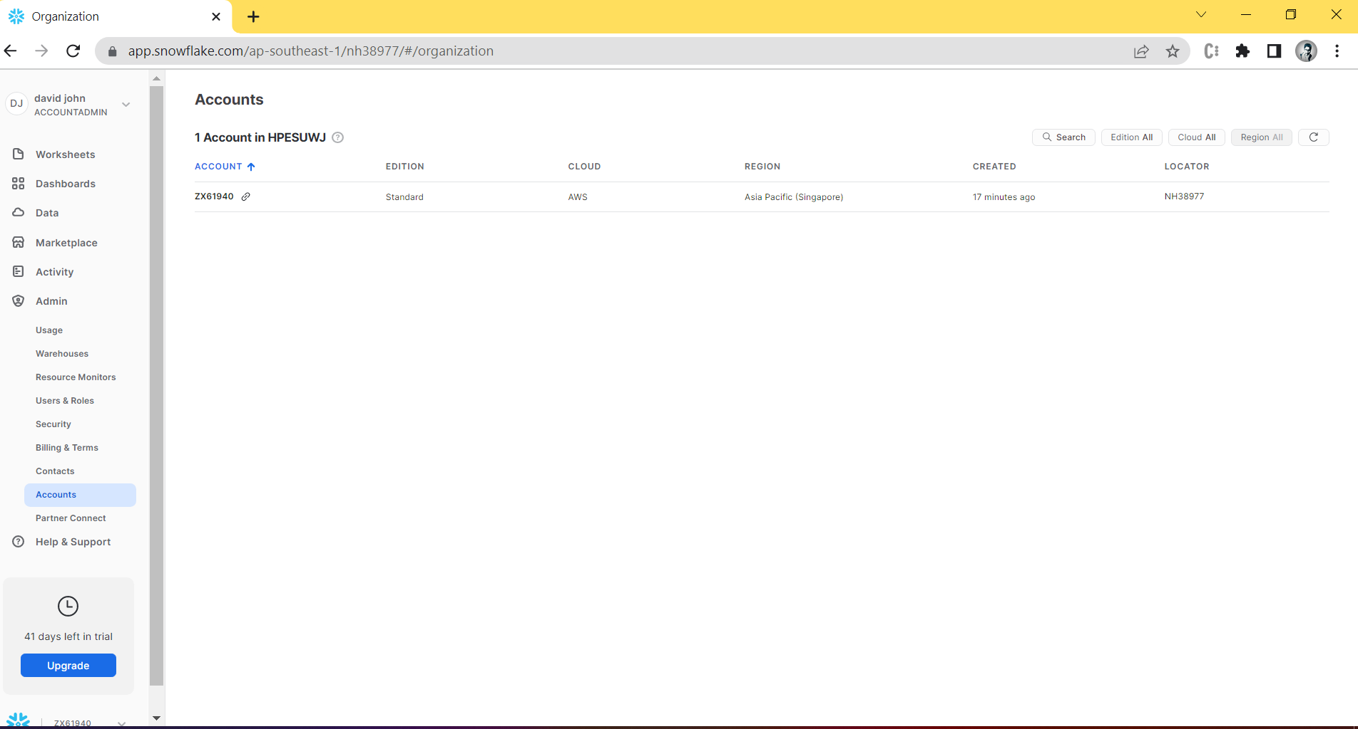
Step 4:- Then Select Admin and go in Account.
Click on that it copy and open a new browser

Slide 13
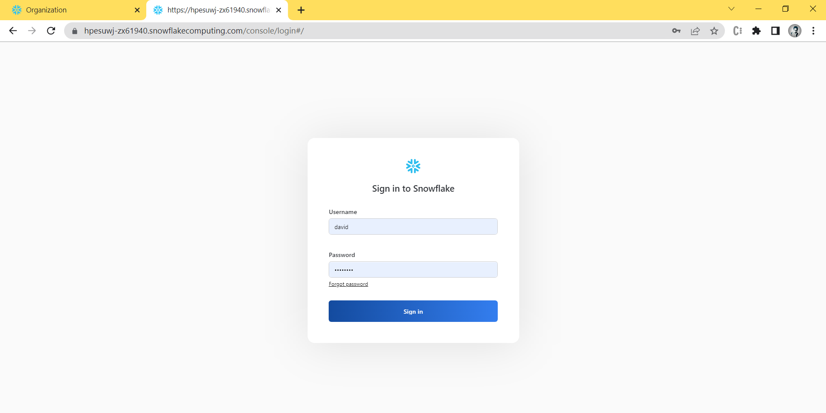
Step5 :-Past the URL and login a snowflake

Slide 14
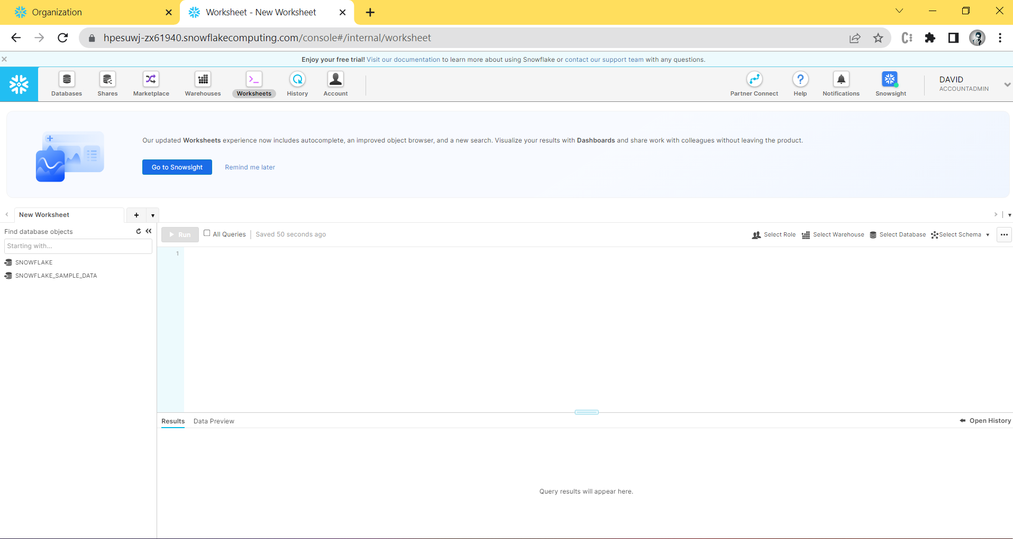
Now you can use a Classica console

Slide 15
Thank YOU

